Slide 1
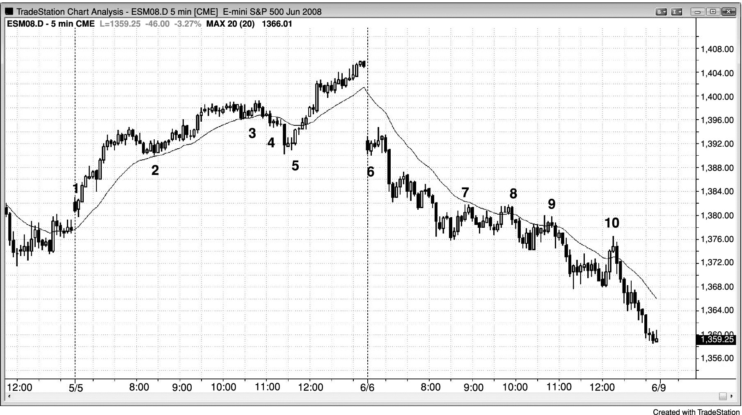
FIGURE 15.1 Late Stop Runs

Slide 2
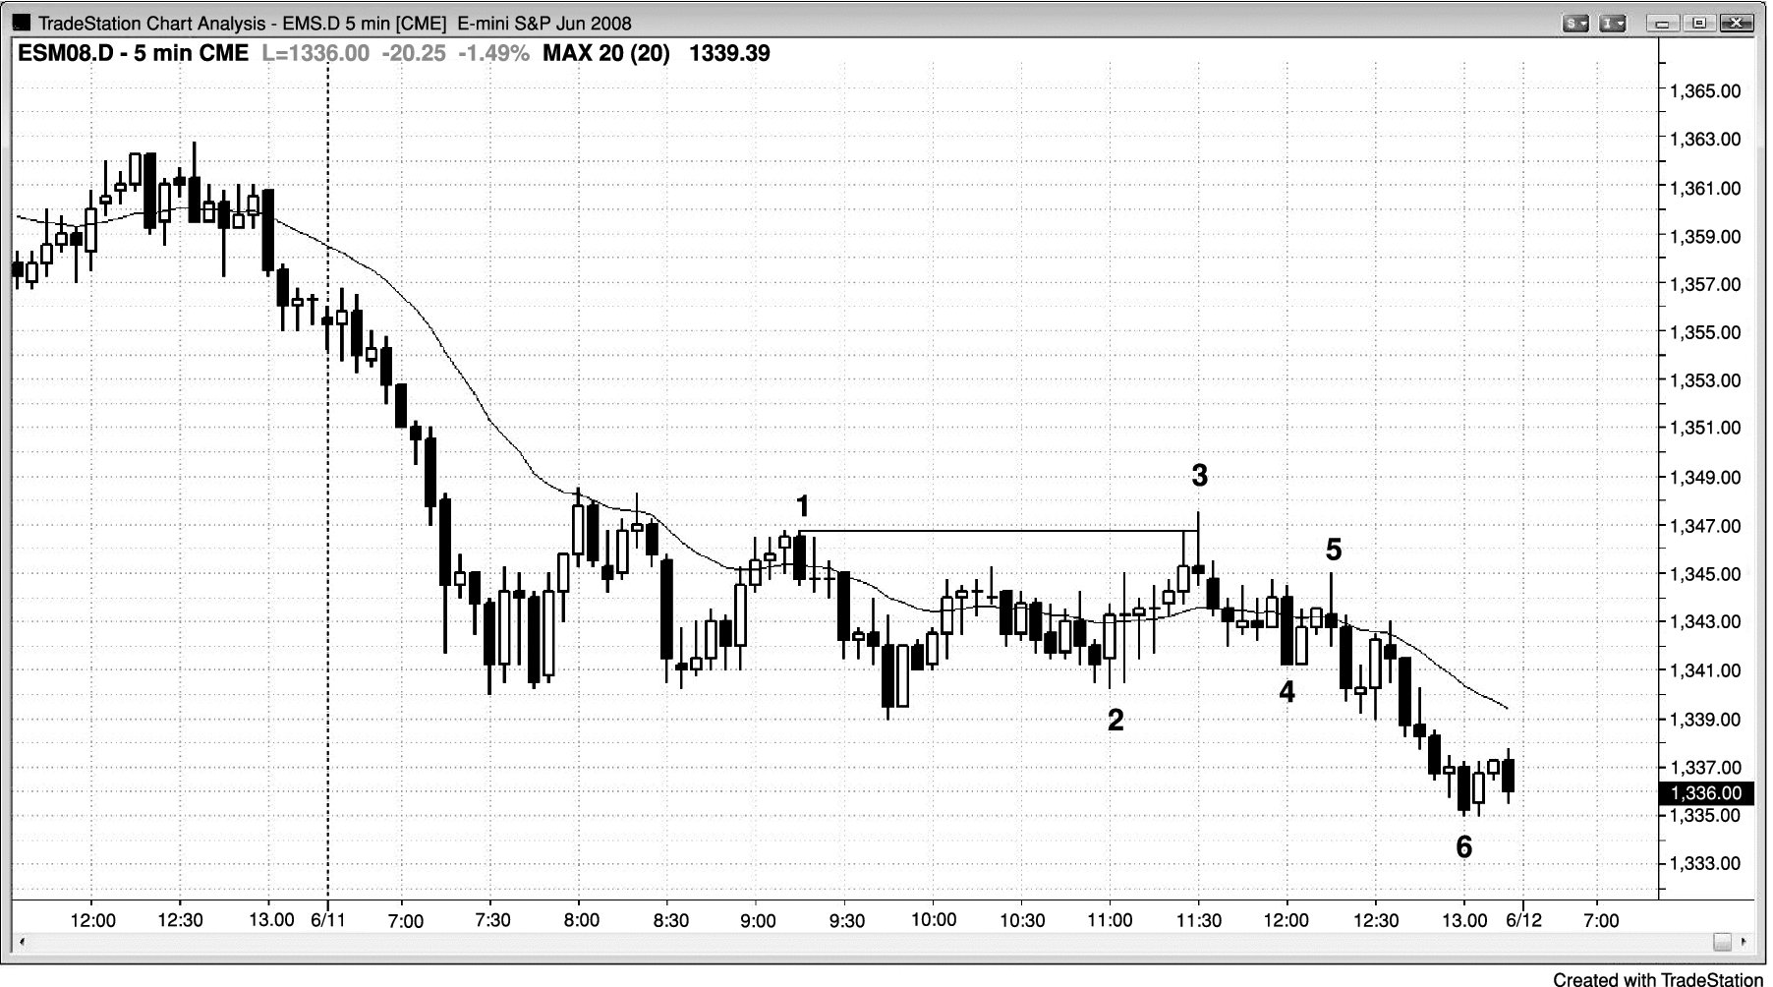
FIGURE 15.2 Late Bull Trap

Slide 3
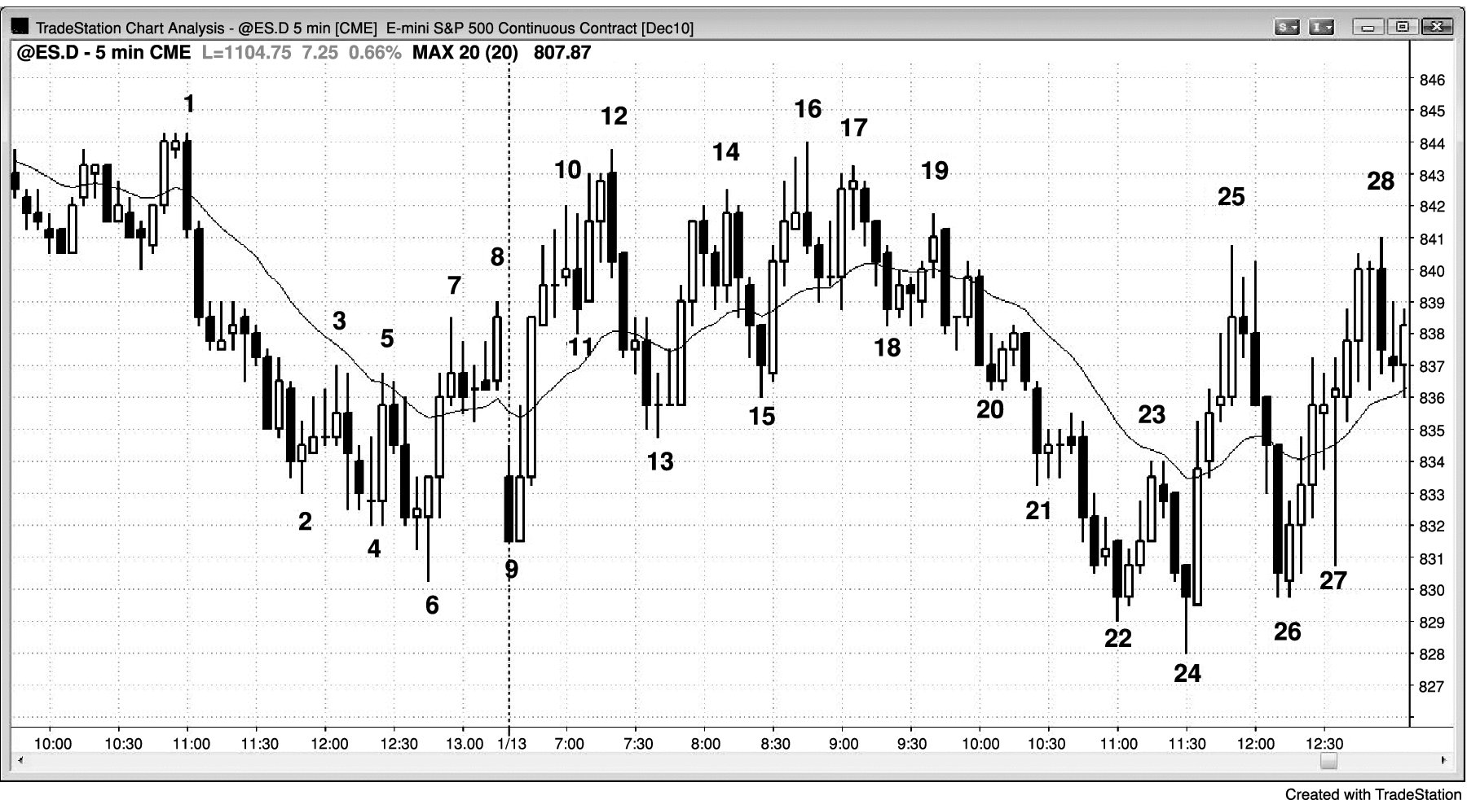
FIGURE 15.3 Late Trap on Trading Range Day

